Slide 1


Azure Functions in a Hybrid World
Jan Egil Ring
Lead Architect, Infrastructure – Crayon AS
@JanEgilRing
Slide credits: @JustinWGrote

Slide 2
Agenda
Understand how Azure Functions differs from other automation capabilities in Azure
Learn how to leverage Azure Functions for hybrid management

Slide 3
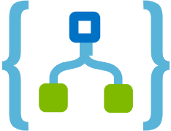



Automation
Deploy and operate infrastructure and services in Azure
Deploy
Respond
Orchestrate
Deliver repeatable and consistent infrastructure as code for testing, staging, and production.
Create event-based automation on deployed resources to diagnose and resolve issues.
Orchestrate your automation across disparate systems in Azure and 3rd party management.
Resource Manager
Logic Apps
Automation
Functions
Event Grid

Slide 4


PowerShell Standard
Windows
PowerShell
PowerShell 7
.NET Framework
.NET Core
Windows
Linux / MacOS / More…
.NET Framework
Notes:
PowerShell Standard is a reference assembly that has been created to assist developers create modules and PowerShell hosts which will run on PowerShell. The reference assembly contains no actual implementation but rather will allow you to use only APIs that exist across different versions of PowerShell.

Slide 5
powershell.exe
pwsh.exe
Windows
PowerShell
PowerShell 7
.NET Framework

Slide 6
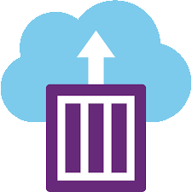




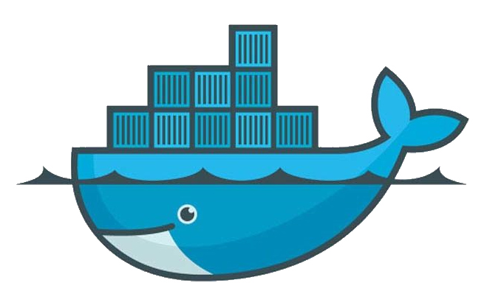
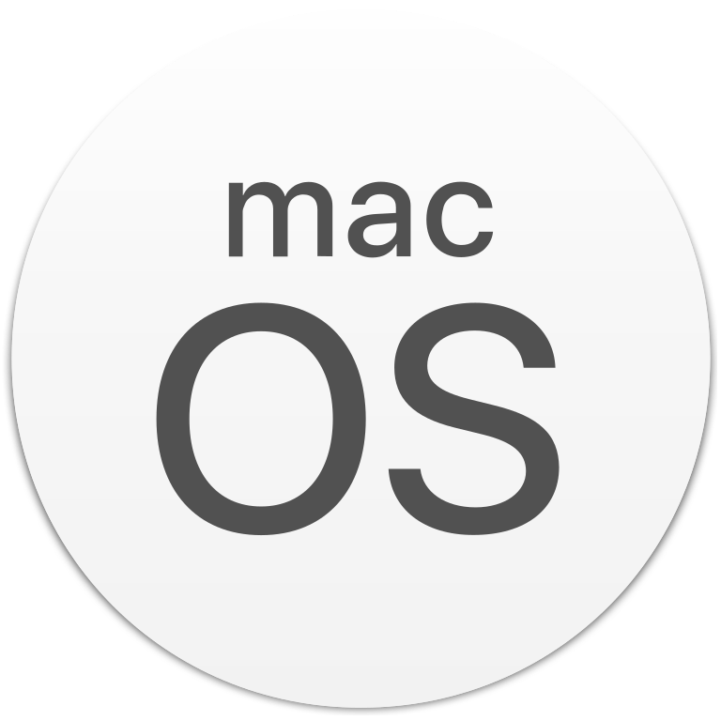
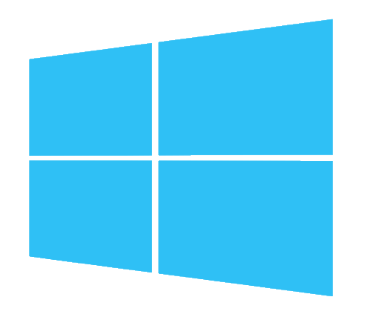
PowerShell 7
Where can I run Powershell?

Slide 7


Azure Functions vs Azure Automation
Azure Functions uses PowerShell Core/7
Azure Automation uses Windows PowerShell
5.1 marks the completion of Windows PowerShell
 | Windows PowerShell | PowerShell Core/7
Cross-Plat Support | Windows only | Windows, macOS and Linux
Side-by-side |  | SxS and portable
Active development | Servicing only
Servicing | via Windows Update | via Microsoft Update
Remoting support | WinRM | WinRM and SSH
.NET CLR | .NET Framework | .NET Core 2.x
Packaging | Ships in Windows & MSU (for down level) | MSI, RPM/DEB repos, Snap, HomeBrew, ZIP
Notes:
Azure Automation currently supports only Windows PowerShell
Uncertain whether this will change
Azure Automation might be easier for the traditional IT Pro
Azure Functions opens up for new ways of thinking
Continue to support Windows PowerShell and provide security fixes

Slide 8
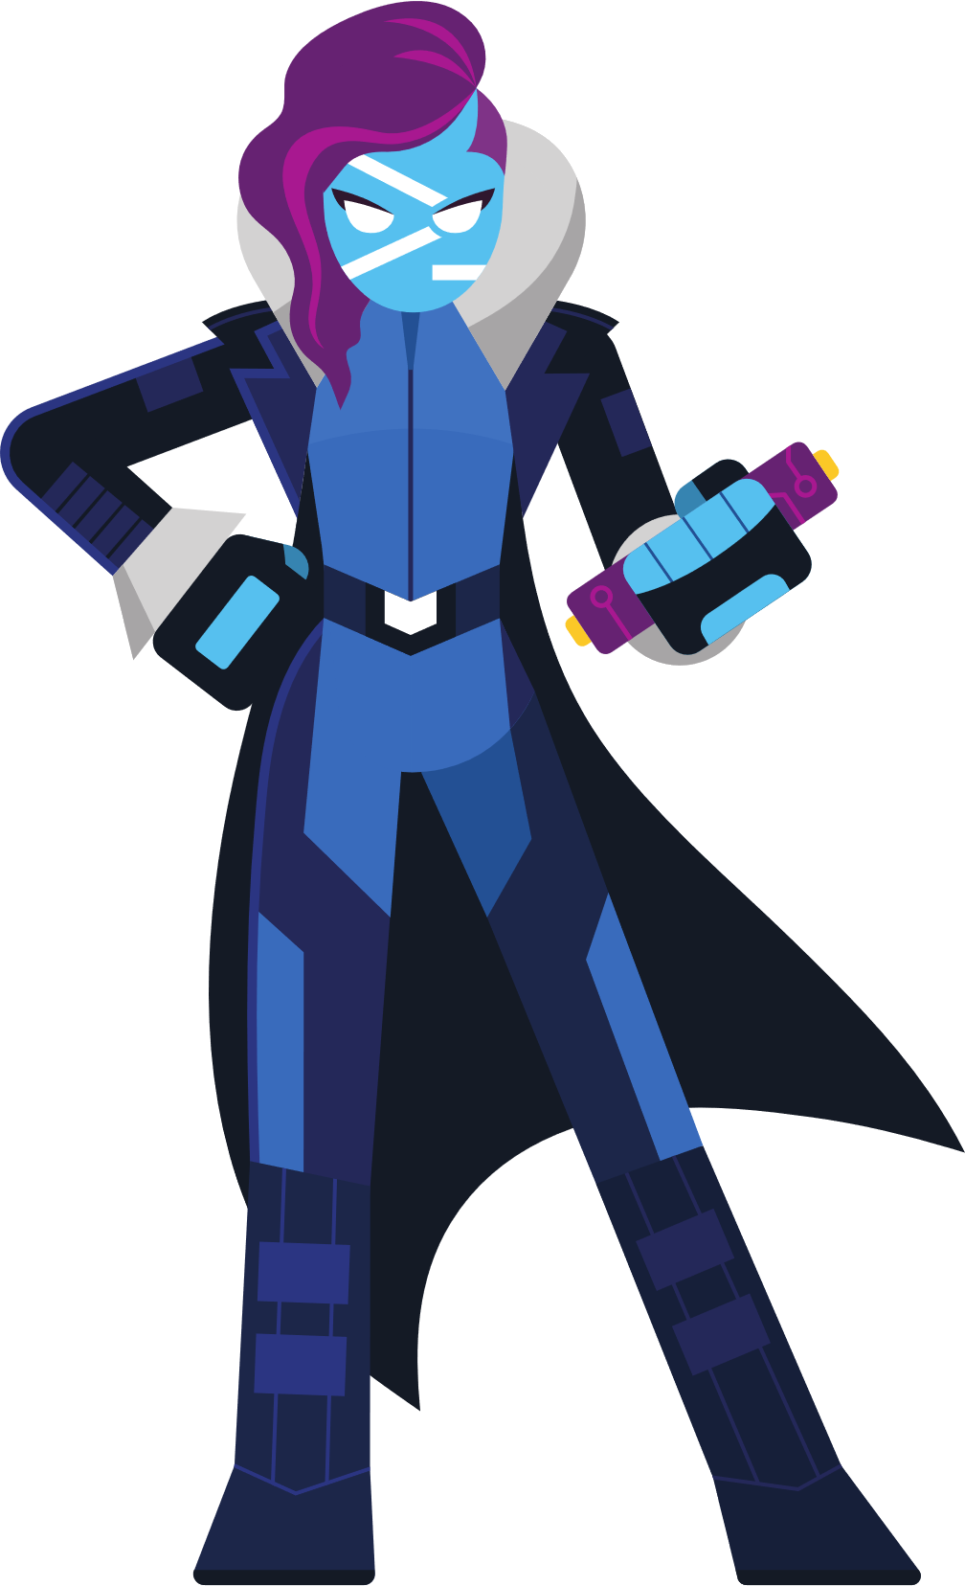
Performance Improvements
Concise Error View and Get-Error
Revamped Invoke-RestMethod and Invoke-WebRequest
Debug on Exception
Foreach -Parallel
Powershell Remoting Over SSH
Windows Module Compatibility
Temp: PSDrive
Invoke-DSCResource xplat
New Operators Pipeline Chain Operators (&&, ||) Ternary Operator ( condition ? true : false ) Null Conditional (??)
Null Coalesce (??=)
Revamped Test-Connection
Runs on .NET Core 3.1 LTS
■ Experimental ■ PS7 ■ PS6
What’s New

Slide 9
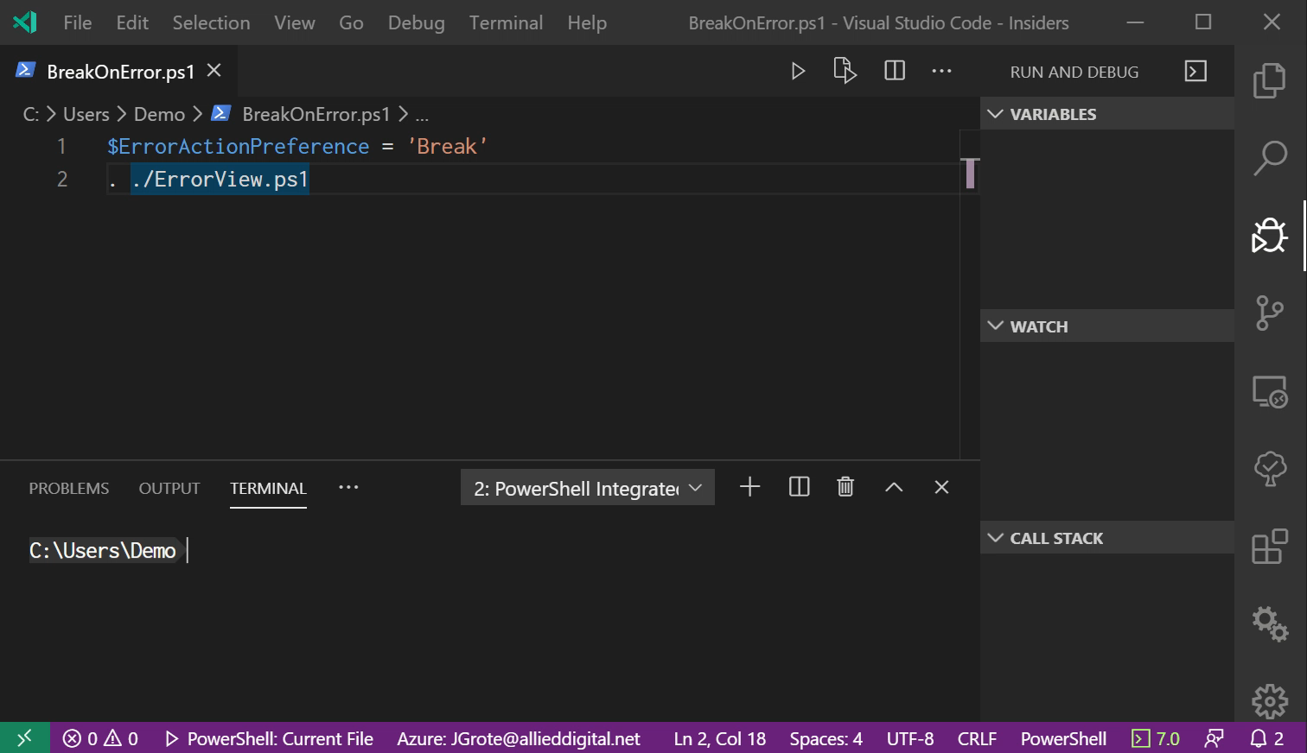
Debug On Exception

Slide 10






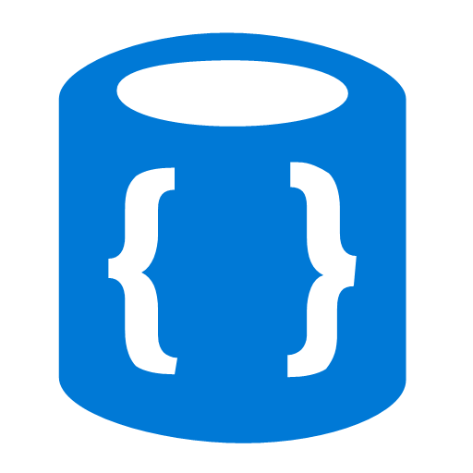


Azure Functions Programming Model
Events
Code
Outputs
React to timers, HTTP, or events from your favorite Azure services, with more on the way
Author functions in C#, F#, Node, Java, Python, PowerShell, and more
Send results to an ever-growing collection of services
Notes:
Inputs: HTTP
Queue
Timer (Cron schedule)
Event Grid Event Hub
Outputs:
Queue
Cosmos DB SendGrid Microsoft Graph
https://docs.microsoft.com/en-us/azure/azure-functions/functions-triggers-bindings#supported-bindings

Slide 11
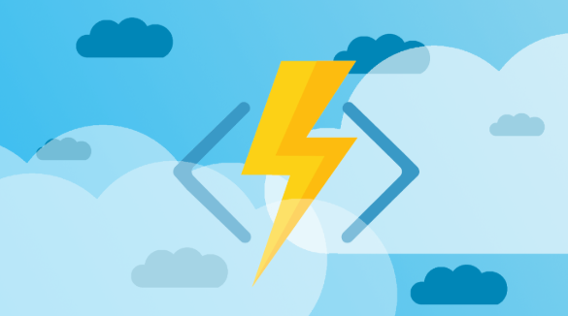


Slide 12
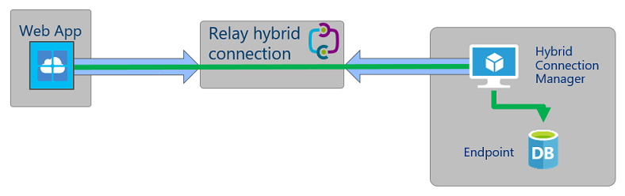
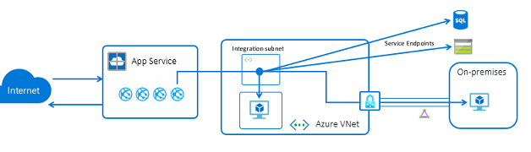
Azure Functions – Hybrid networking
Two options
Hybrid Connections
Virtual Network Integration
Notes:
Hybrid Connections is both a service in Azure and a feature in Azure App Service. As a service, it has uses and capabilities beyond those that are used in App Service.
Within App Service, Hybrid Connections can be used to access application resources in other networks. It provides access from your app to an application endpoint. It does not enable an alternate capability to access your application. As used in App Service, each Hybrid Connection correlates to a single TCP host and port combination. This means that the Hybrid Connection endpoint can be on any operating system and any application, provided you are accessing a TCP listening port. The Hybrid Connections feature does not know or care what the application protocol is, or what you are accessing. It is simply providing network access.
The Azure Functions Premium plan (sometimes referred to as Elastic Premium plan) is a hosting option for function apps. The Premium plan provides features like VNet connectivity, no cold start, and premium hardware. Multiple function apps can be deployed to the same Premium plan, and the plan allows you to configure compute instance size, base plan size, and maximum plan size. F
Private network connectivity
Azure Functions deployed to a Premium plan takes advantage of new VNet integration for web apps. When configured, your app can communicate with resources within your VNet or secured via service endpoints. IP restrictions are also available on the app to restrict incoming traffic.
When assigning a subnet to your function app in a Premium plan, you need a subnet with enough IP addresses for each potential instance. We require an IP block with at least 100 available addresses.
Longer run duration
Azure Functions in a Consumption plan are limited to 10 minutes for a single execution. In the Premium plan, the run duration defaults to 30 minutes to prevent runaway executions. However, you can modify the host.json configuration to make this unbounded for Premium plan apps (guaranteed 60 minutes). The feature is easy to set up, but that doesn't mean your experience will be problem free. If you encounter problems accessing your desired endpoint, there are some utilities you can use to test connectivity from the app console.

Slide 13
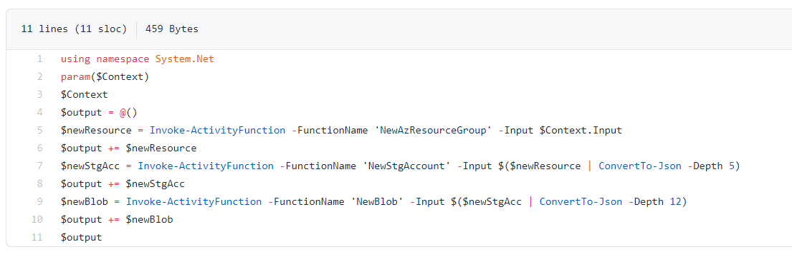
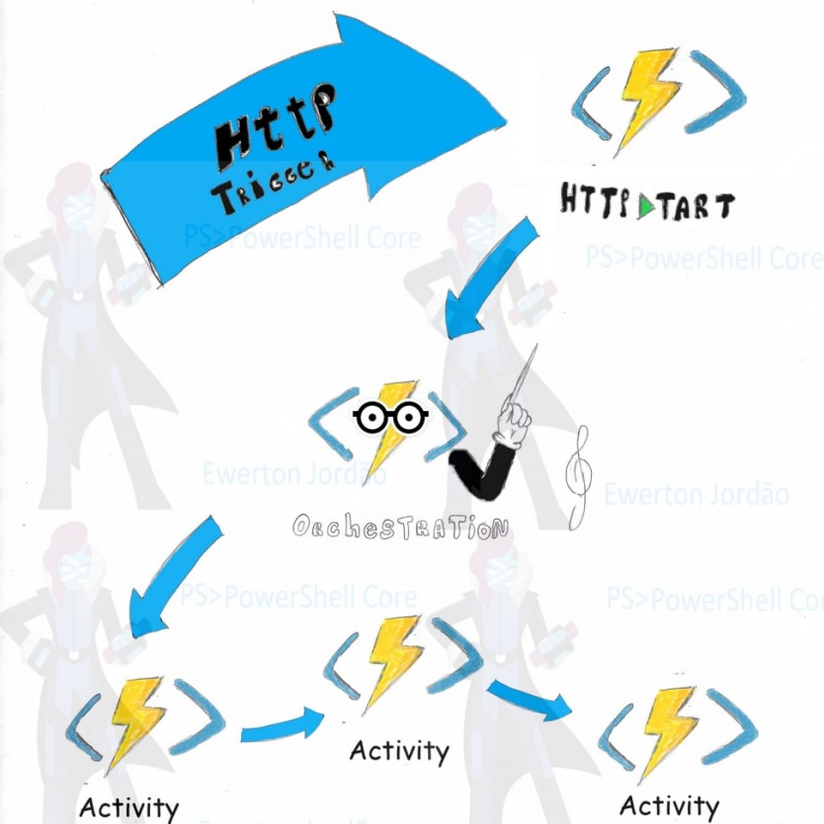
Bonus tip: Durable Functions
https://docs.microsoft.com/en-us/azure/azure-functions/durable/quickstart-powershell-vscode
Notes:
https://dev.to/ewertonjordao/azure-durable-functions-powershell-7-chaining-pattern-57g8
Fan-out model governed by an orchestration function.
Activity functions (same idea as workflow + activities) have the same constraints for timeouts as regular functions, but with an orchestrator setup, you can partition the work across as many activities as you need. Orchestrator functions are nice because they keep track of where you are in the work, and will pick up at the last point of failure if something goes wrong.
Probably a topic for a separate talk.

Slide 14
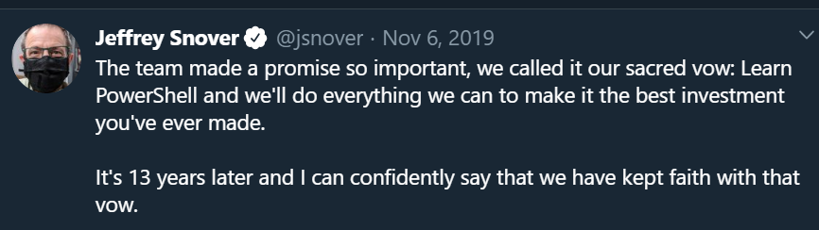

Slide 15
Summary
Azure Functions uses PowerShell Core/7
Azure Automation uses Windows PowerShell
Options for Hybrid Management in Azure Functions
VNet integration (requires Premium Plan)
Hybrid Connections (requires agent)

Slide 16
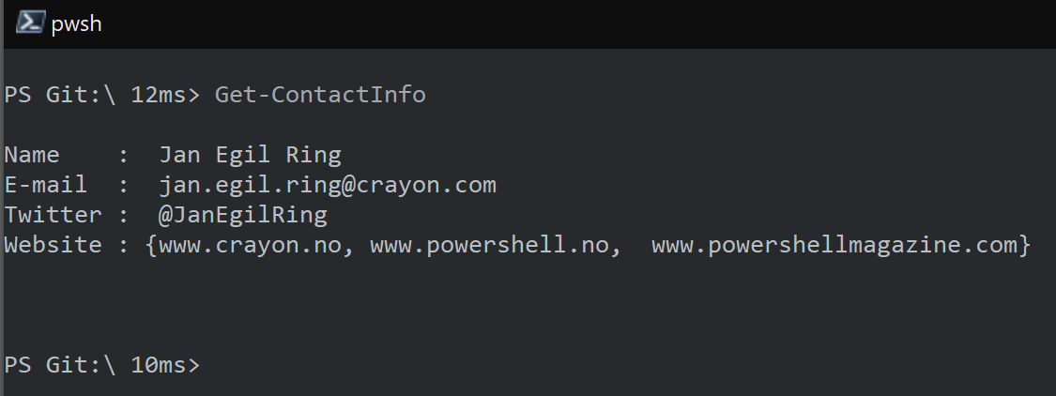
Thank you!
NEXT: Open Discussion, Q&A

